Slide 1

Interactive Games for Complex EME Optimisation
DSTL Electromagnetic Activities Programme
Ed Butcher | AI Concepts and Exploitation team

Slide 2
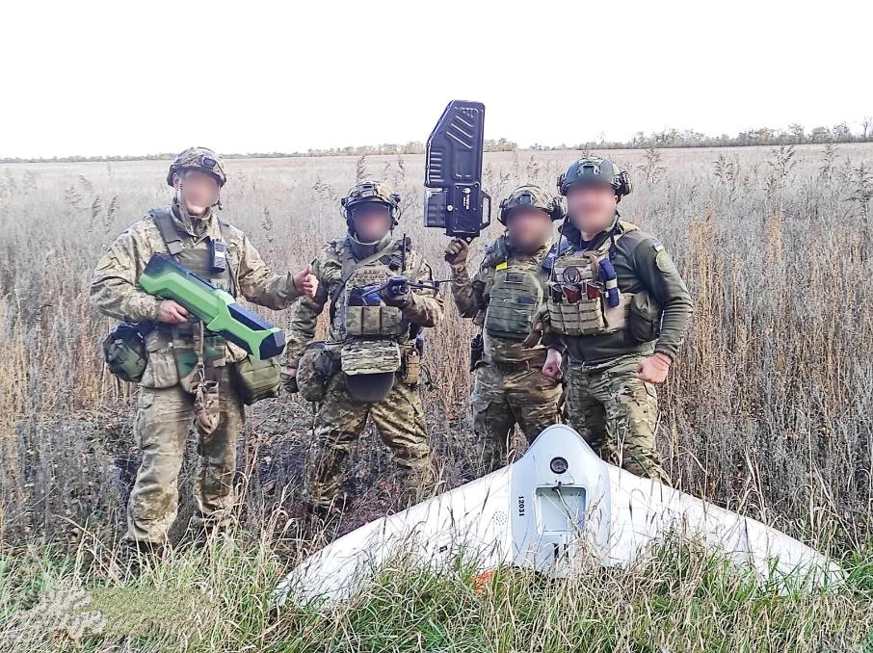
OUTPLACE
The Electromagnetic Enterprise
Modern conflicts show we need to be informed of a fast-changing electromagnetic environment and have sufficient agility in our capability to act on this.
The Electromagnetic (EM) Enterprise is a Technologically Integrated approach that brings together all military capability utilising the EM Spectrum (EMS).
The Integrated EMA Options (IEMAO) project is building a standards-based EM Enterprise that demonstrates the ability to bring these functions together for greater operational success.
The enterprise must be robust against adversarial threats, including those at machine-speed, or that seek to undermine the systems-of-systems EM enterprise
Soldiers of Dnipro Brigade of National Guard of Ukraine showing a downed Russian Grifon 12 UAV in Donetsk Oblast.
https://ngu.gov.ua | CC BY 4.0

Slide 3
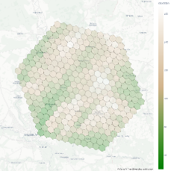
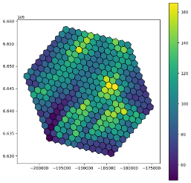
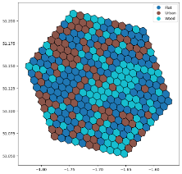
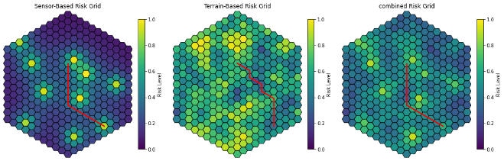
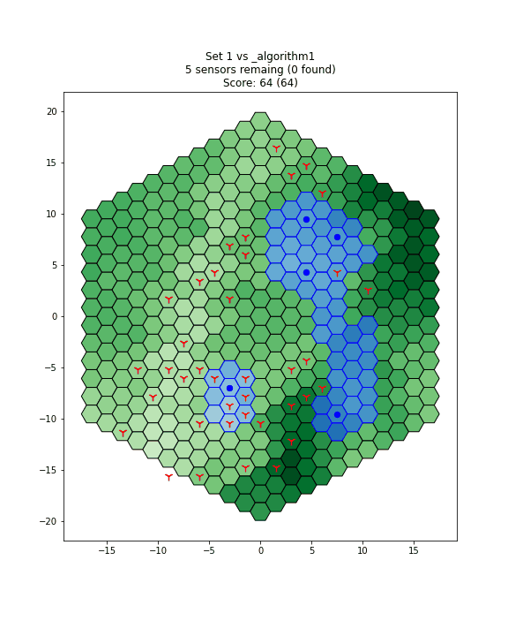
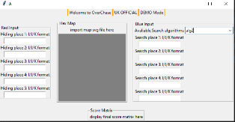


OUTPLACE
What is OUTPLACE?
To build the required agility in the EM enterprise, we need tools that adapt to adversarial challenges.
Outplace is a flexible framework that uses interactive games to develop and test the decision-support algorithms that could power these tools.
Encourages adversarial thinking and adaptive strategies.
Leverages a crowdsourcing-style approach to gather diverse solutions.
Promotes more robust optimisation by considering both sides of the problem.

Slide 4
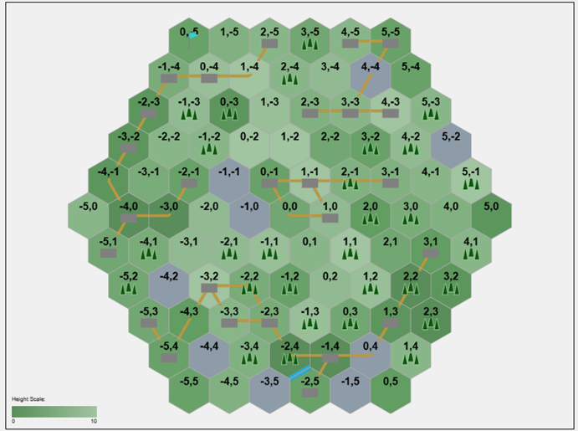
OUTPLACE
Interactive example
OUTPLACE Demo ISMOR 42
Place 3x sensors
The enemy is preparing a raid into this area, you may pre-position 3 sensors to support your defence.
Sensors require line of sight to be effective.
Enemy UAV sweep has time to cover ~50% of the area to detect and neutralize sensors.
  Woodland: 3× slower to search than clear ground
  Built-up areas: 5× slower to search
Your score is based on the unique area covered by surviving sensors.
Mark 3 sensor placements on the handout map
Results will (hopefully) be shared at the end.
Name:
Name:
Sensor 1:
Sensor 1:
/
/
Sensor 2:
Sensor 2:
/
/
Sensor 3:
Sensor 3:
/
/

Slide 5

OUTPLACE
Why Gaming?
Explore adversarial optimisation in a dynamic, interactive format.
Introduce an adversarial edge to experimentation.
Games encourage creative problem-solving, rapid iteration, and diverse approaches.
Provide a safe, repeatable environment to test strategies under uncertainty.
Foster engagement and collaboration across disciplines—from analysts to operators.
Generated with Microsoft Copilot

Slide 6
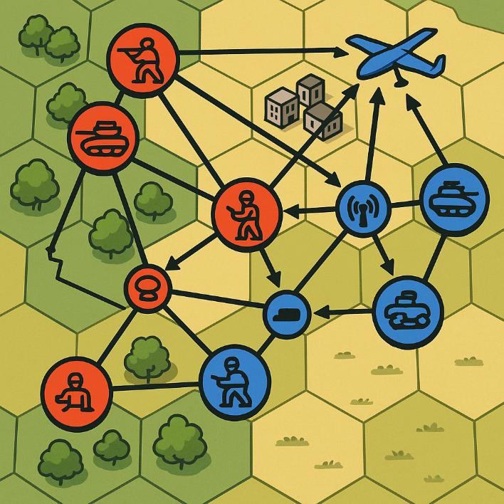
OUTPLACE
Possible applications
Current Version:
  Sensor / Effector Placement
  Optimising positioning of EM assets to maximise coverage while minimising detection risk.
  Routing
  Planning movement paths for assets (e.g., UAVs) to maximise effectiveness
Future Developments:
  Decoys / Deception
  Exploring strategies to mislead adversaries
  Networks
  Planning resilient communication and sensing networks under adversarial conditions.
  Spectrum Allocation / Multirole Systems
  Allocating EM spectrum resources efficiently across multifunction platforms in contested environments.
  Force Mix
  Assessing different combination of EM systems
Generated with Microsoft Copilot

Slide 7
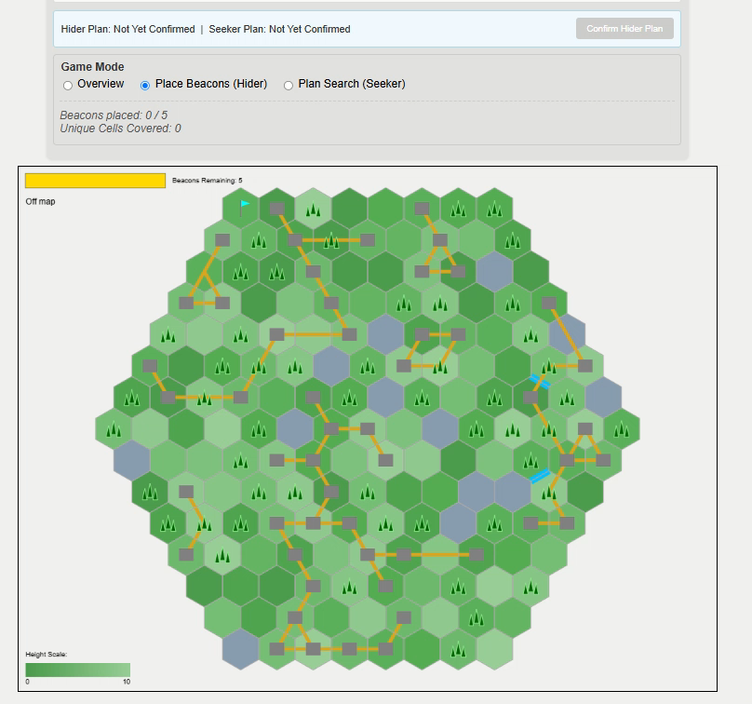
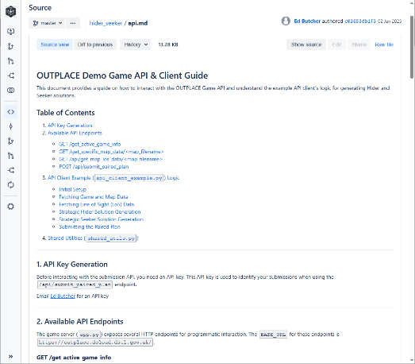
OUTPLACE
Solver Interface
Flexible input: Accepts both human-generated and algorithmic solutions via a web GUI or API.
Technique-agnostic: Compatible with a wide range of approaches—from simple heuristics to reinforcement learning agents.
Modular & extensible: Designed to support rapid integration of new solver types and evolving scenarios.
Iterative refinement: Enables feedback loops for solution tuning and performance benchmarking.
Fair comparison: Standardized interface ensures consistent evaluation across diverse methods.

Slide 8

OUTPLACE
Analytical Methods
Solutions are evaluated using a simulation-based scoring system.
Currently using a custom lightweight simulation;
Exploring integration with more detailed external models. Interest in linking to operational outcomes through existing OA models.
Current metrics include coverage and detection risk, but can tailor to the scenario.
Enables benchmarking, cross-comparison and evaluation, of a range of approaches
Generated with Microsoft Copilot

Slide 9
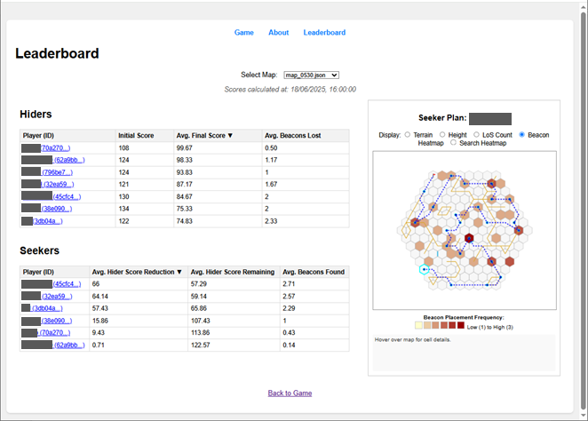
OUTPLACE
Evaluation (and Feedback Loop)
Compare Red and Blue strategies across diverse scenarios.
Assess solution effectiveness using a range of metrics.
Provide feedback to participants to support refinement of methods.
Enables iterative improvement through repeated testing.
Potential for more integration with the visualisation techniques elements of IEMAO research.

Slide 10
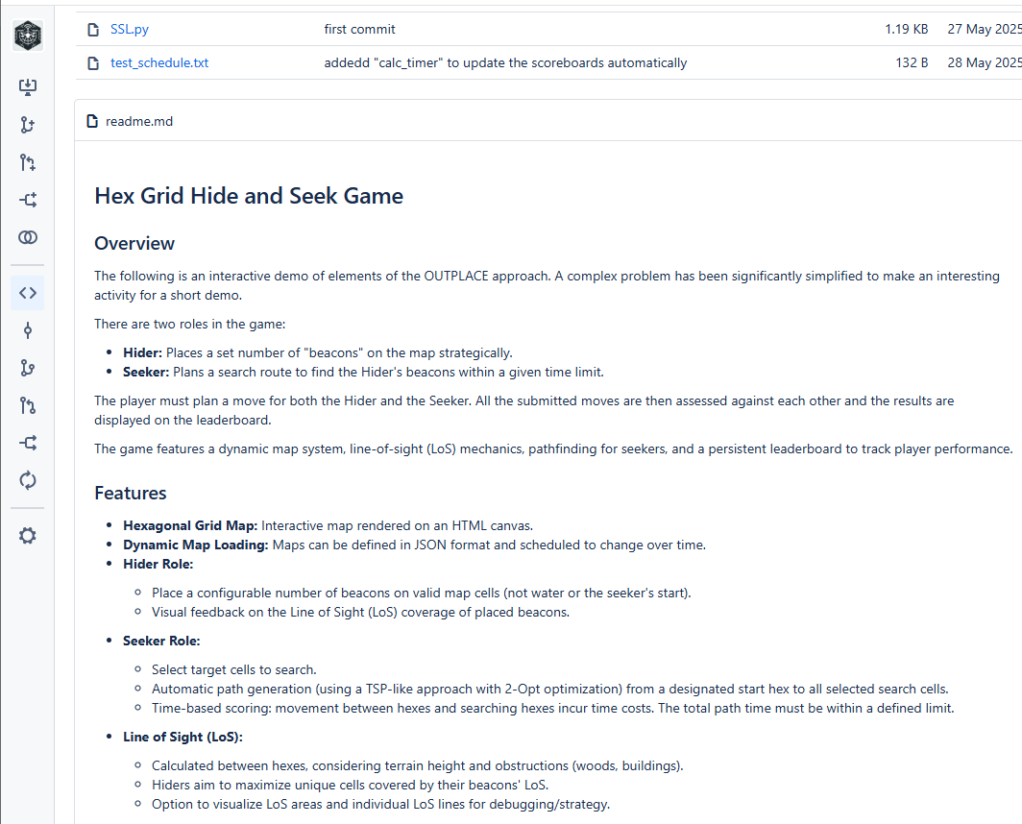
OUTPLACE
Software "stack"
Built in-house following relevant standards and practices.
Evolving from initial proof-of-concept to a robust, extensible framework.
Enables rapid prototyping and experimentation within the team.
Designed to support collaboration and innovation; currently exploring open-sourcing interfaces to simplify participation.

Slide 11

OUTPLACE
Key Takeaways
Turns complex EW optimisation challenges into a flexible, testable framework.
Enables the development of resilient strategies in adversarial settings.
Promotes a red-teaming mindset and adaptive thinking.
Serves as a platform for experimentation into EM enterprise decision support.
Designed for iterative optimisation with a view towards real-world operational demands.
Support Forces of Ukraine Command showing a Ukrainian-made Anklav jammer https://mil.gov.ua/ | CC BY 4.0

Slide 12
Questions?
(and hopefully…) Demo Results

Slide 13

OR
© Crown copyright (2025), Dstl
This information is licensed under the Open Government Licence v3.0. To view this licence, visit https://www.nationalarchives.gov.uk/doc/open-government-licence/
Where we have identified any third party copyright information you will need to obtain permission from the copyright holders concerned.
Any enquiries regarding this publication should be sent to: centralenquiries@dstl.gov.uk.

